Slide 1
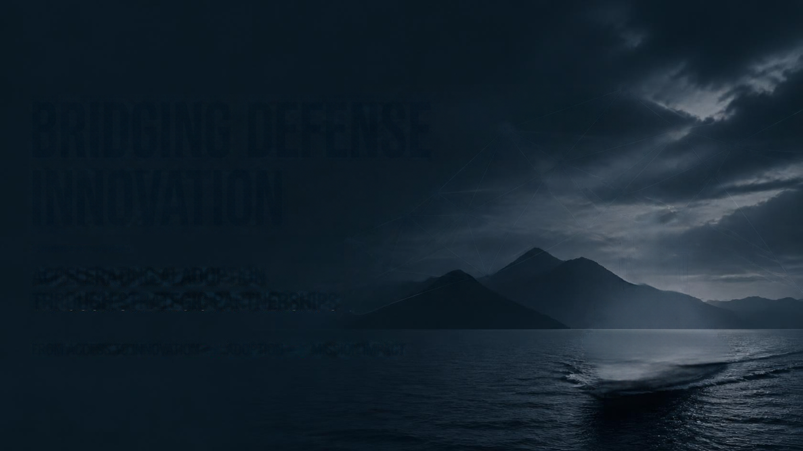

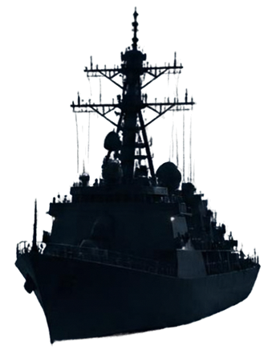
Bridging Defense & Innovation
ACCELERATING AI ADOPTION
THROUGH STRATEGIC PARTNERSHIPS

Slide 2
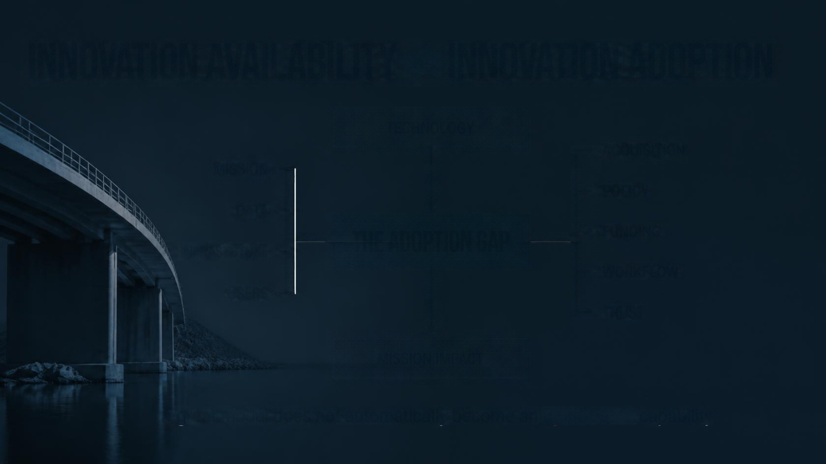








Innovation Availability
Innovation Adoption
TECHNOLOGY
ACQUISITION
MISSION
POLICY
DATA
The Adoption Gap
FUNDING
INFRASCULTURE
WORKFLOW
USERS
TRUST
MISSION IMPACT
A great model does not automatically become an operational capability

Slide 3
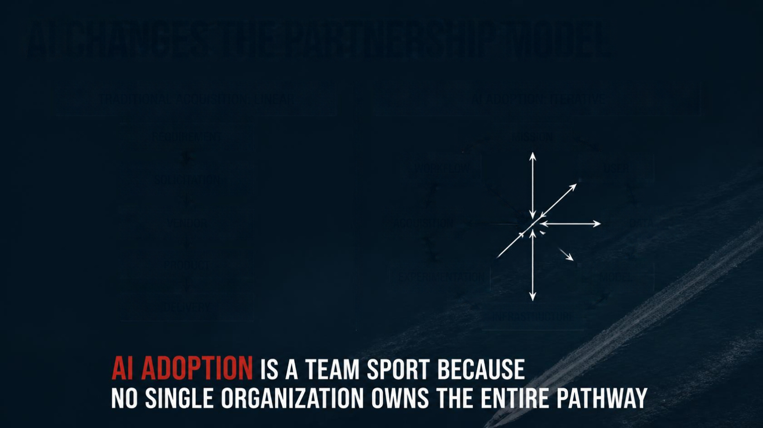


























AI CHANGES THE PARTNERSHIP MODEL
TRADITIONAL ACQUISITION: LINEAR
AI ADOPTION: ITERATIVE
REQUIREMENT
MISSION
WORKFLOW
USER
SOLICITATION
VENDOR
ACQUISITION
DATA
PRODUCT
EXPERIMENTATION
MODEL
DELIVERY
INFRASTRUCTURE

Slide 4
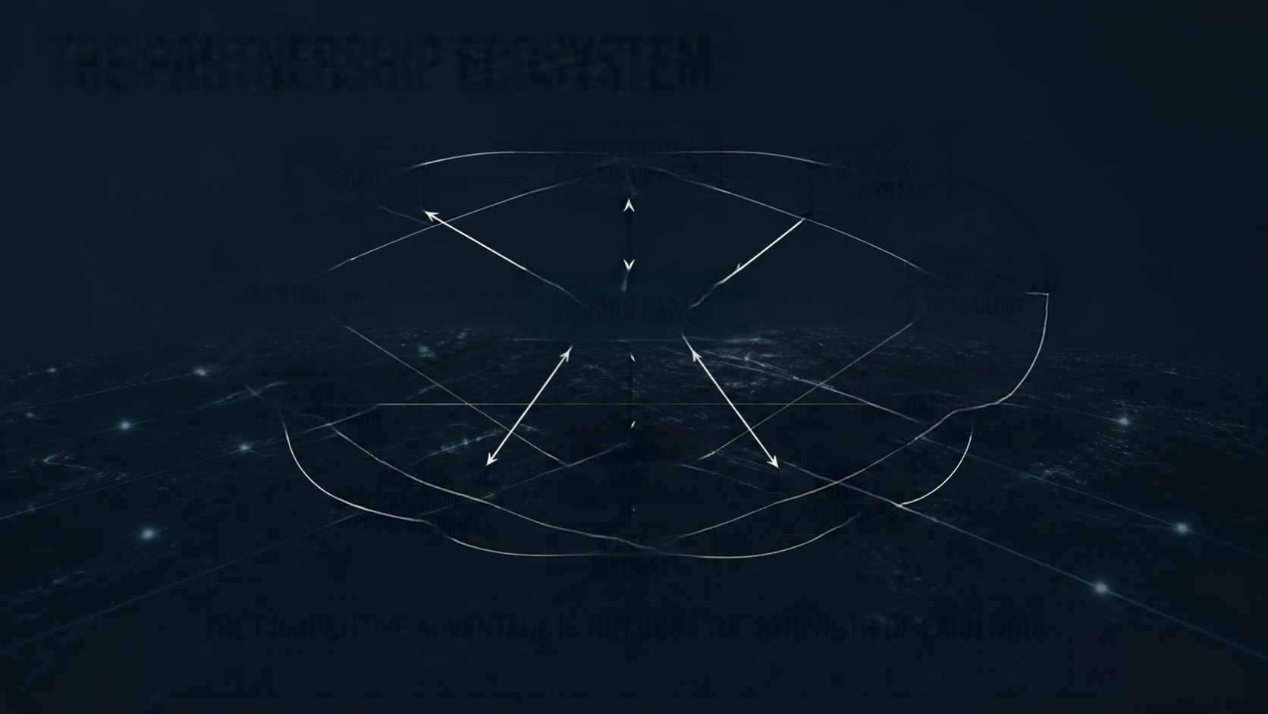


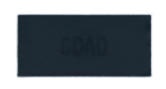
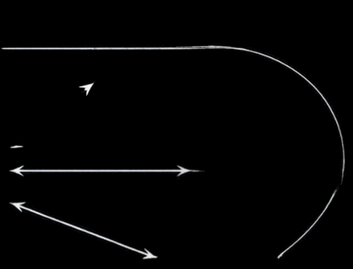







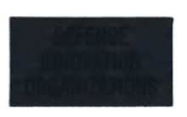



THE PARTNERSHIP ECOSYSTEM
WARFIGHTERS / MISSION OWNERS
CDAO
SERVICES + COCOMS
ACQUISITION
MISSION IMPACT
COMMERCIAL TECHNOLOGY
CLOUD + INFRASTRUCTURE
CAPITAL
RESEARCH + LABS
DEFENSE INNOVATION ORGANIZATIONS
POLICY / AUTHORITIES
ALLIES + PARTNERS
THE COMPETITIVE ADVANTAGE IS NOT JUST THE STRENGTH OF EACH NODE.
IT IS THE SPEED BETWEEN THEM.

Slide 5







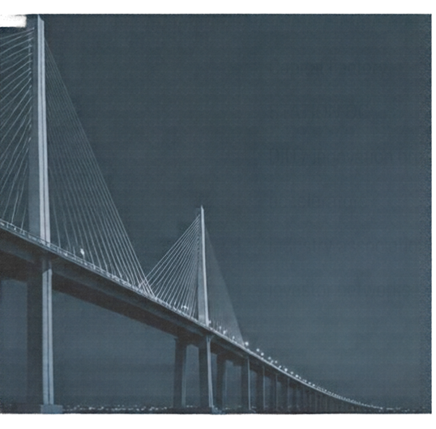
WE HAVE THE BRIDGES.
NOW WE NEED THE NETWORK.
Access
Translation
Adoption
DIU / innovation organizations
STATION DC
Tech incubators/accelerators
Industry associations
Investor networks
Mission ↔ Technology
Government ↔ Startup
Requirement ↔ Commercial Capability
Operator ↔ Investor
Policy ↔ Market
Experiment
Contract
Integrate
Operate
Learn
Scale
THE BEST PARTNERSHIPS Reduce the Transaction costs of innovation, TURNING RELATIONSHIPS INTO REPEATABLE SYSTEMS BEHAVIOR.

Slide 6
















The New DOD AI Model
pace-set
learn
fast-follow
scale
DoW Pace-Setting Projects
Swarm Forge
Agent Network
Ender's Foundry
Open Arsenal
Project Grant
GenAI.mil
Enterprise Agents
create
reusable
infrastructure /
authorities /
pathways
PACE-SETTING PROJECT
FAST FOLLOWERS
scale
across
missions
learn
what works
remove
blockers
foundational enablers
data
infrastructure
models
policy
talent

Slide 7















DON’T SCALE THE PILOT.
SCALE THE PATHWAY.
PILOT #1
DATA
ACCESS
SECURITY
INFRASTRUCTURE
CONTRACT
POLICY
USER
WORKFLOW
PILOT #2
SHOULD NOT SOLVE ALL SIX AGAIN.
BUILT ON THE PATHWAY. FOCUS ON THE MISSION.
PILOT #10
FASTER. CHEAPER. ROUTINE.

Slide 8
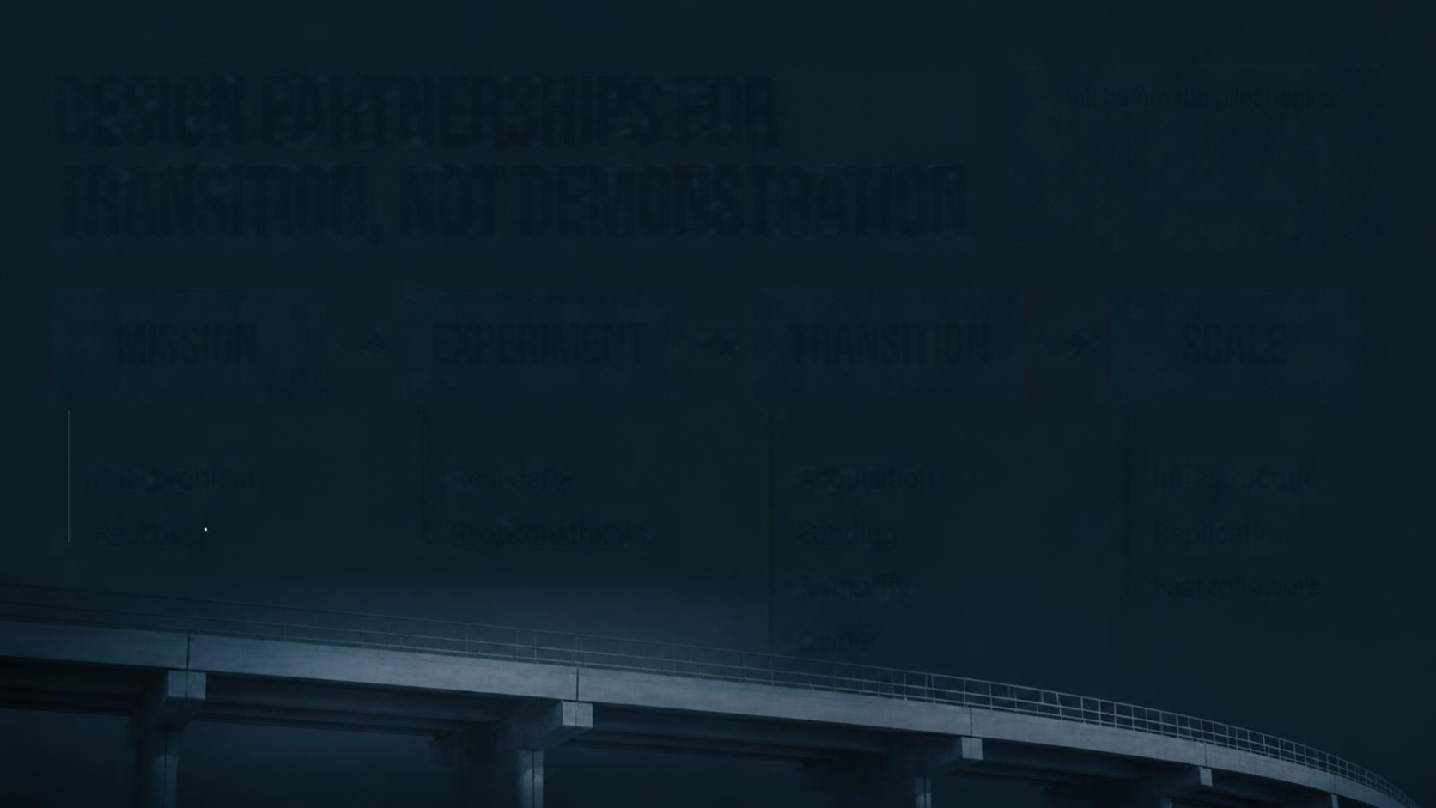








Design Partnerships for Transition, Not Demonstration
Ask before the pilot begins:
What Happens If This Works?
Mission
Experiment
Transition
Scale
Real problem
Real data
Acquisition
Infrastructure
Real user
Real constraints
Funding
Replication
Authority
Fast followers
Owner

Slide 9












FROM BRIDGES TO NETWORKS
GOVERNMENT
AMERICA'S ADVANTAGE WILL NOT COME FROM GOVERNMENT OUT-INNOVATING THE COMMERCIAL SECTOR.
ALLIES
OPERATORS
AND IT WILL NOT COME FROM THE COMMERCIAL SECTOR SOLVING NATIONAL-SECURITY PROBLEMS ON ITS OWN.
INFRASTRUCTURE
MISSION ADVANTAGE
TECHNOLOGISTS
IT WILL COME FROM HOW EFFECTIVELY WE CONNECT THEM.
DATA
INDUSTRY
THE GOAL ISN’T TO BUILD ANOTHER BRIDGE EVERY TIME.
ACQUISITION
CAPITAL
IT’S TO BUILD A NETWORK THAT GETS BETTER EVERY TIME WE USE IT.

Slide 10
COMMENTS / QUESTIONS
Contact me at:
colleenlaughlin@stationdc.org

